Slide 1


System aberration correction for whole brain imaging with a light sheet microscope
M.Caroline Müllenbroich, Ludovico Silvestri, Leonardo Sacconi & Francesco S. Pavone

Slide 2
Outline
intro
Microscope Setup
Light-sheet microscopy
Optical setup
Sample preparation
Adaptive Optics
Introduction
Wavefront sensorless aberration correction
Random Search Algorithm
Results
System aberration correction
Outlook

Slide 3
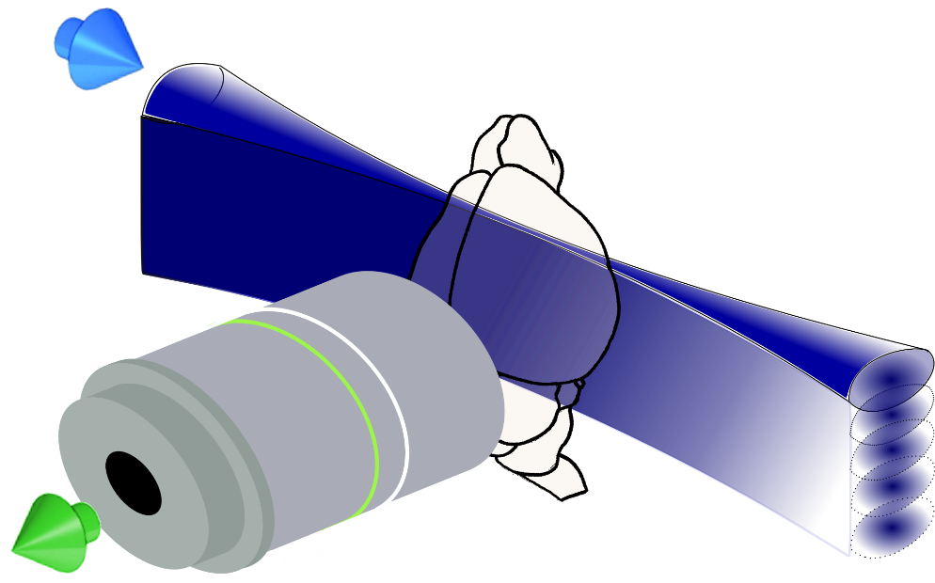
Light-sheet microscopy
Single axis scan creates light sheet
Projection into specimen at 90° to detection objective
Imaging of large, clarified mouse brains
3D datasets through stitching of adjacent stacks

Slide 4
galvo
Illumination
Light-sheet generation
Detection
561 nm
515 nm
491 nm
445 nm
405 nm
f 200
Nikon
10x
0.3NA
17.5mm WD
f 50
f 140
f 350
v
f 100
Camera
f 200
f 180
DMM
LP 552
PBS
Olympus
1.0NA
25X
8mm WD
LP 503
filter
wheel
LP 466
f 350
f 150
f 100
LP 427
f 150
LM
f 50
AOTF
I1
I2
galvo
f 200

Slide 5
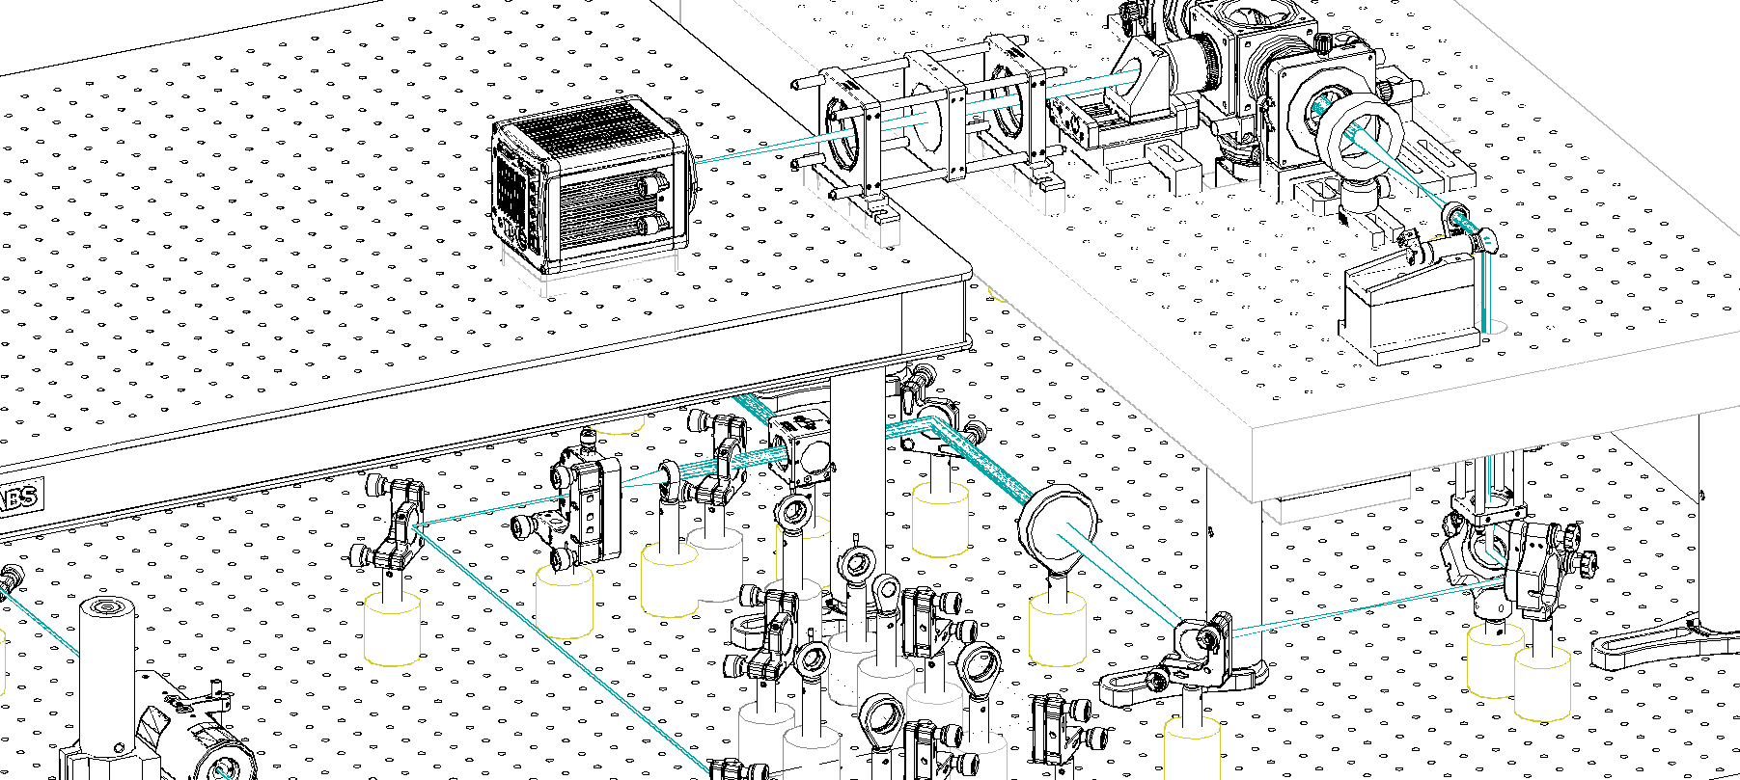
Spatial arrangment of the LSFM

Slide 6
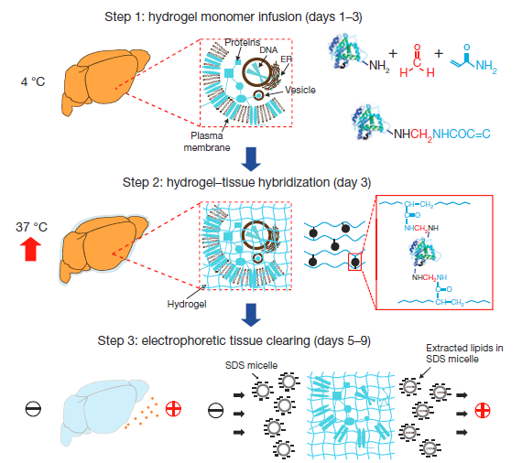
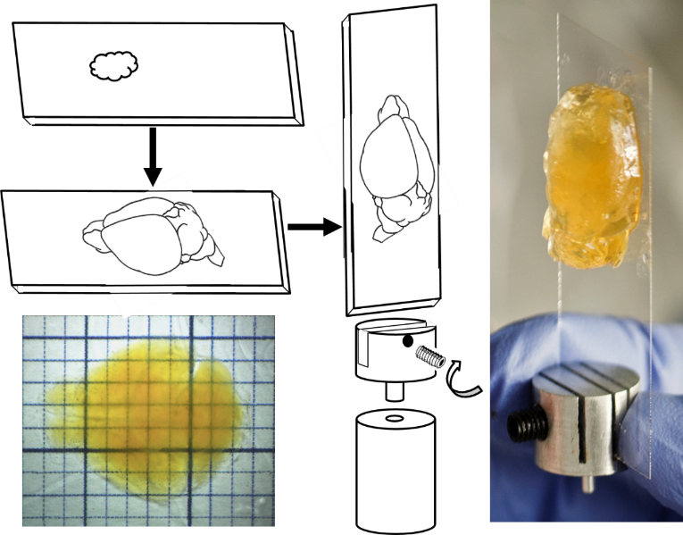

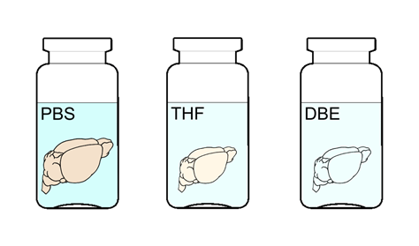
Sample preparation
PBST
30% TDE
63% TDE
Transgenic animals
Refractive index matching
CLARITY protocol
Mounting

Slide 7
Tissue clearing
CLARITY transforms intact tissue into nano-porous, hydrogel-hybridized, lipid-free form
fully assembled, optically transparent and macromolecule-permeable
Step 1: formaldehyde crosslinks the tissue and the hydrogel monomers to proteins
Step 2: polymerization of the biomolecule- conjugated monomers into a hydrogel mesh
Step 3: extraction of the lipids with ETC
Step 4: refractive-index matching with water-soluble clearing agent 2,2'-thiodiethanol (TDE) (n=1.45 with 63%TDE in PBS).
PBST
30% TDE
63% TDE
[Chung et al. Nature 2013]

Slide 8
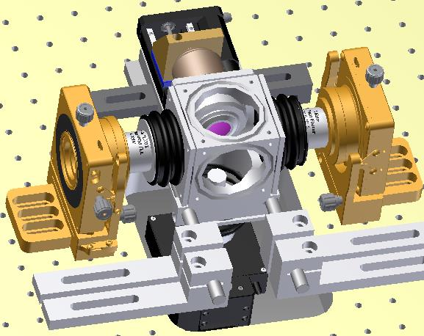
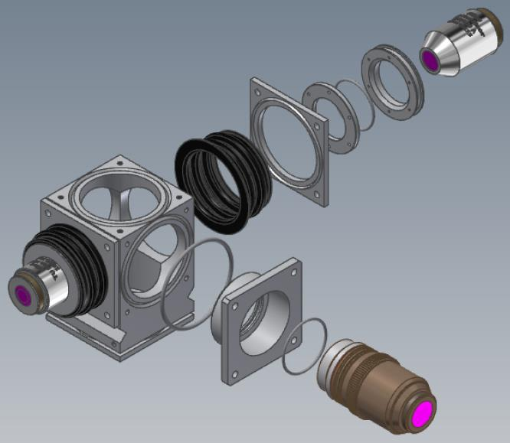
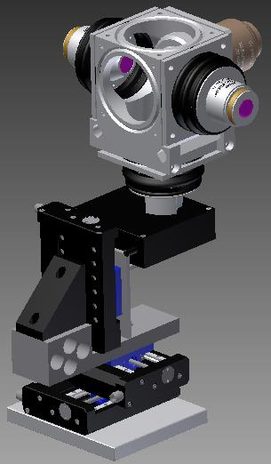
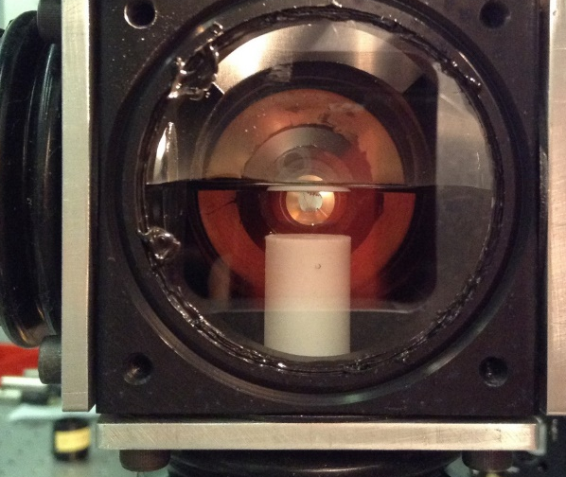
Sample chamber
z
x

Slide 9
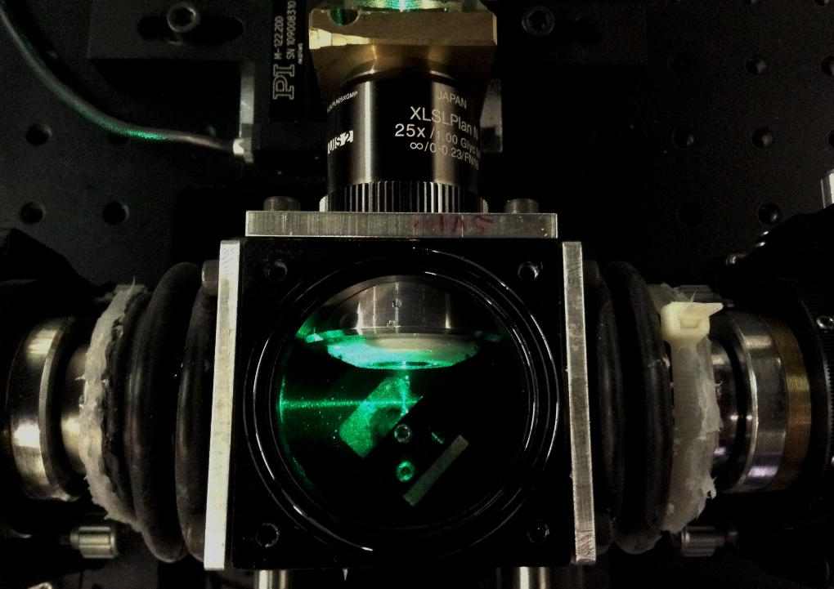
Olympus high RI immersion objective
correction collar for n = 1.41 - 1.52
Olympus, XLSLPLN25XGMP
25x magnification
1.0 NA
EFL 7.2mm
WD 8mm
depth of field: 1.1µm

Slide 10
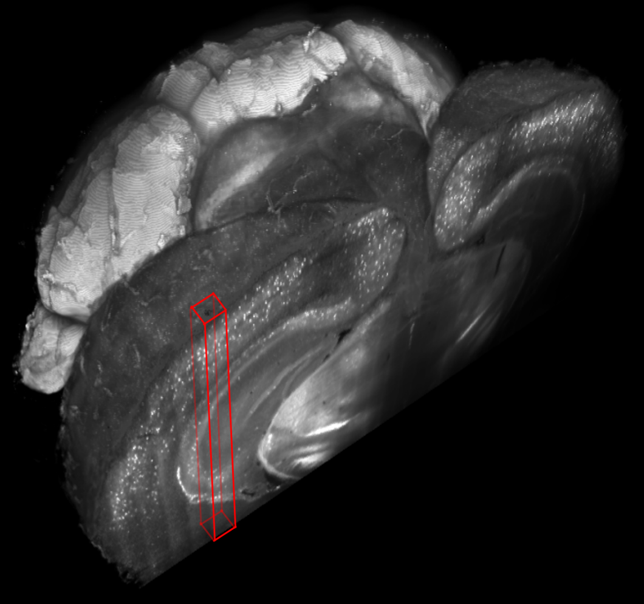
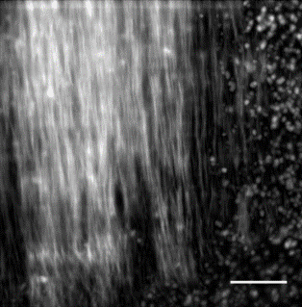
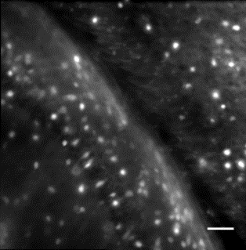
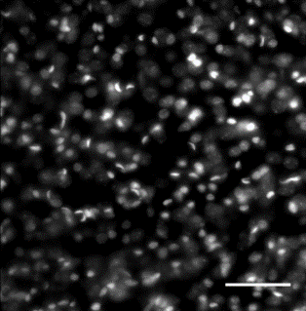
Whole mouse brain tomograhpy
A
B
C
PV
PV
GAD
PI
Transgenic mouse brains treated with CLARITY and cleared with TDE 63% imaged with Olympus, 25X objective.
3D rendering of a parvalbumin-dTomato brain.
3D rendering of stacks from PV-dTomato mouse brain, GAD-dTomato mouse brain, PI stained mouse brain, scale bar = 400µm.
(C,D,E) High resolution insert, of the stack corresponding to red boxes in C, scale bar = 100µm.
D
GAD
E
PI

Slide 11
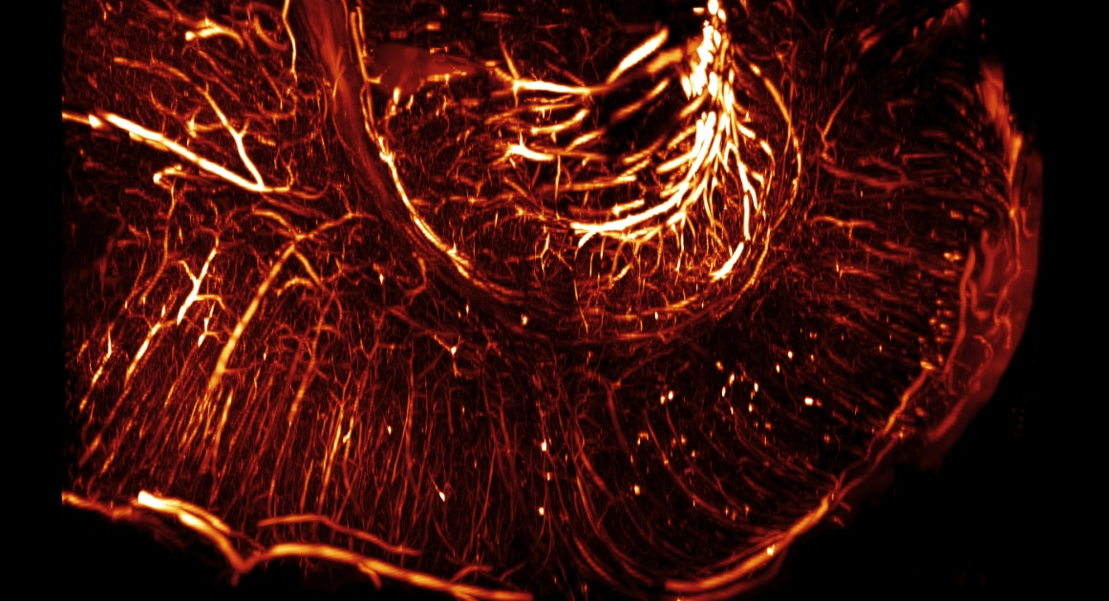
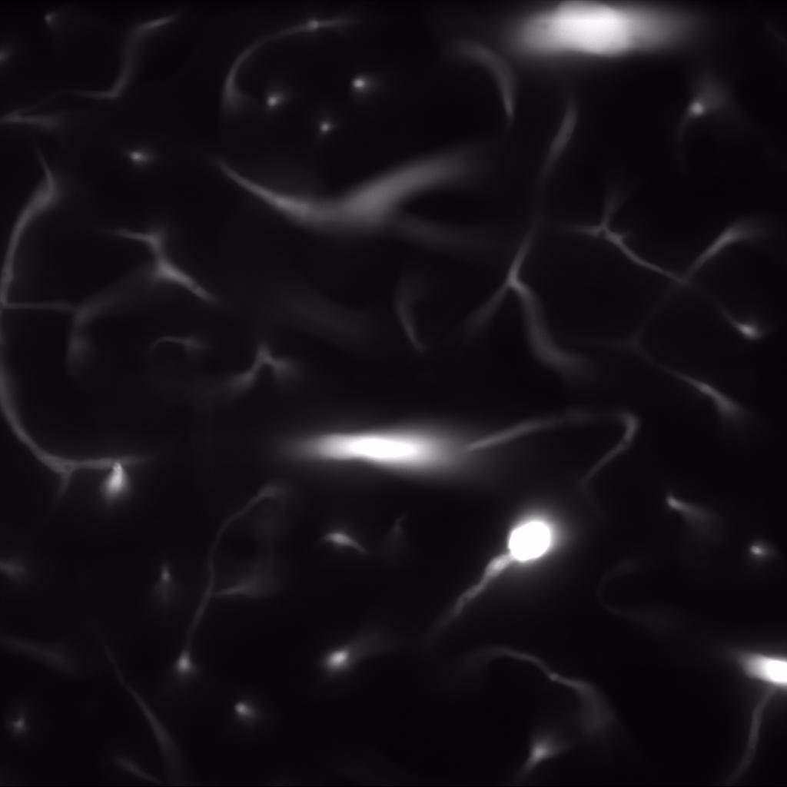
FITC-albumin labelling of vasculature
Tomographie of one rat hemisphere
Additional perfusion with monomeric solution of FITC-albumin to stain vasculature
Automatic segmentation of vasculature fails with highly aberrated images

Slide 12
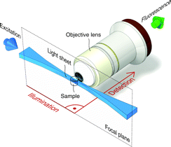
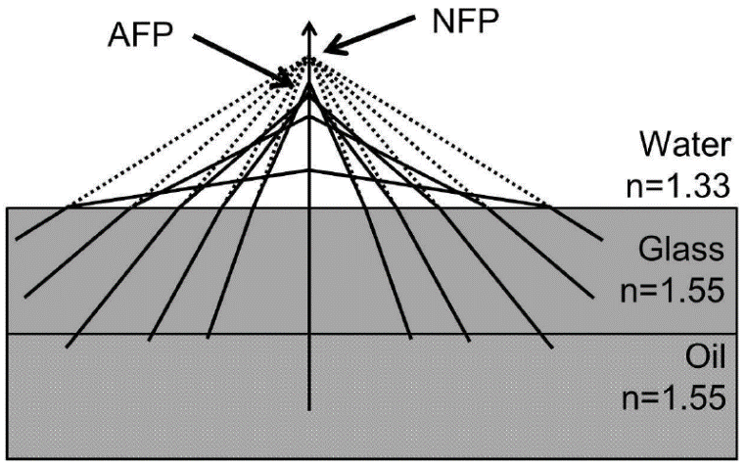
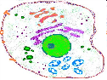
Aberrations in SPIM
In light sheet microscopy illumination and detection light paths are completely uncoupled from each other
→Each light path encounters its own aberrations
→Each focal plane is independently affected
Spherical aberration

Slide 13
Adaptive Optics (AO)
Compensation of optical aberrations arising also in cleared samples
Principle: use of shaped wavefront with equal but opposite distortion to that introduced by the sample
Wavefront generated by deformable membrane mirror (DMM)
DMM shape determined by random search optimisation algorithm

Slide 14
Start: initial shape from LUT
Select Random Actuator
Selection weighed with Gaussian distribution choosing central actuators more often than those in periphery
Change Actuator Voltage
Change limited by percentage of total actuator stroke
Iterations
Yes
Record Merit Factor
Improvement?
No
Voltage change is accepted
Voltage reverts to previous value
At least a 100 successful iterations?
No
Yes
SOLUTION

Slide 15
Improvement in
MF within last n iterations?
Yes
No
Continue optimisation
Activate compensation:
Apply best mirror shape
Measure MF for m iterations
Calculate mean and σ of m measurements
Keep best MF
Replace best MF with mean
Resume optimisation

Slide 16
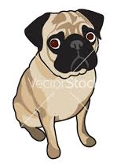
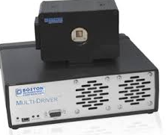
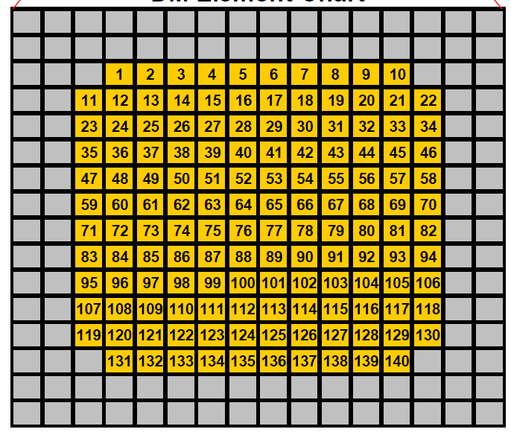
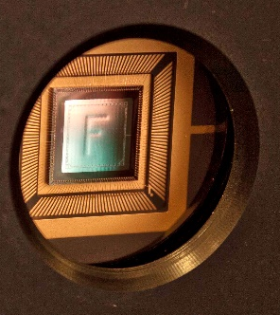
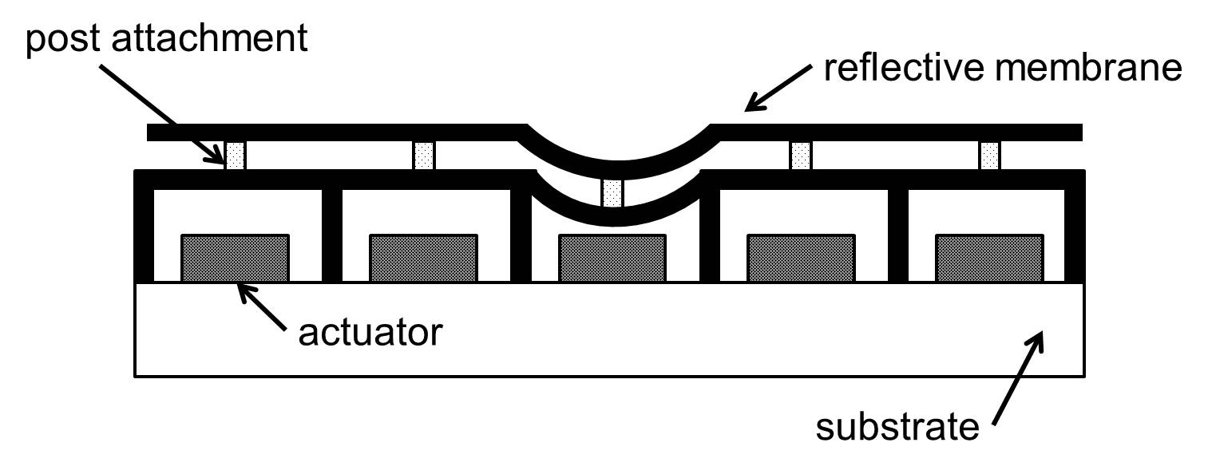

Deformable Membrane Mirror
BMC multi | MEMS
Technology | el.static
Coating | Al
Actuators | 140
Stroke | 3.5 μm
Pitch | 400µm
Av. Step size | < 1nm
Actuated area (D) | 4.4mm
AR coating | 400-1100nm
Frame rate (max) | 34kHz

Slide 17
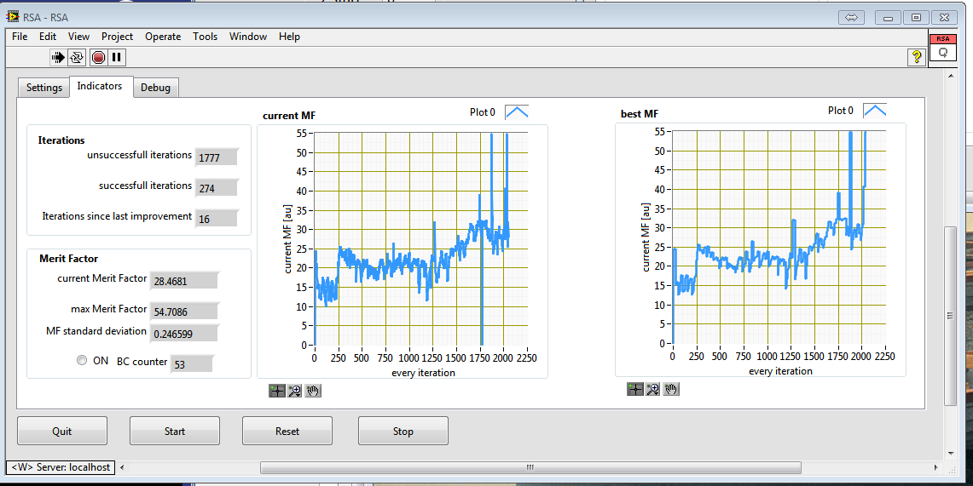
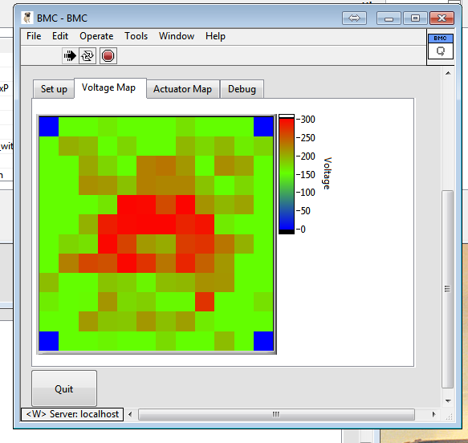
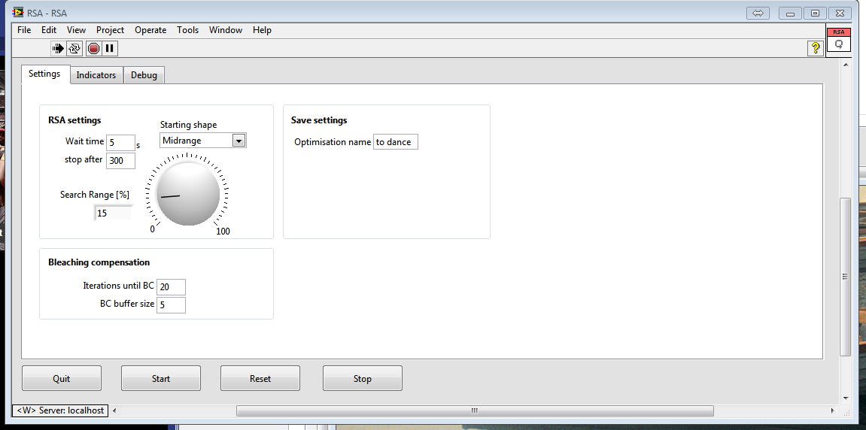

Slide 18

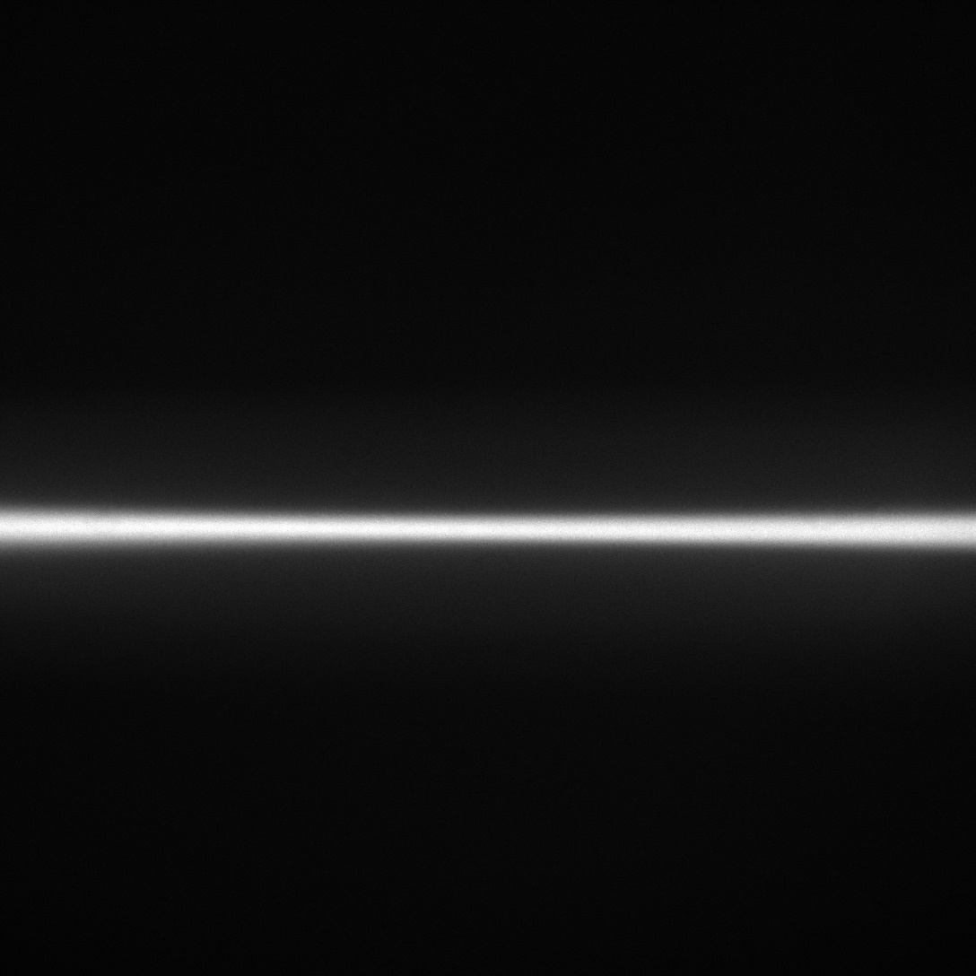
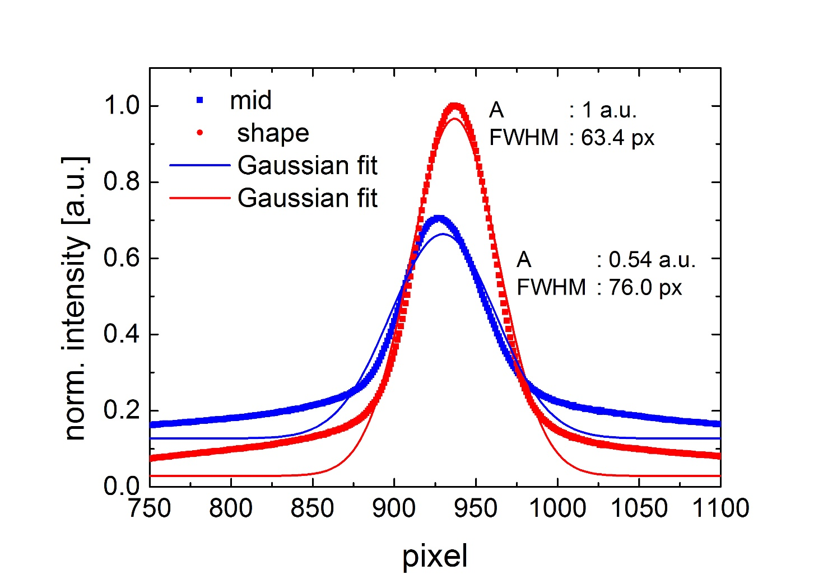

Slide 19
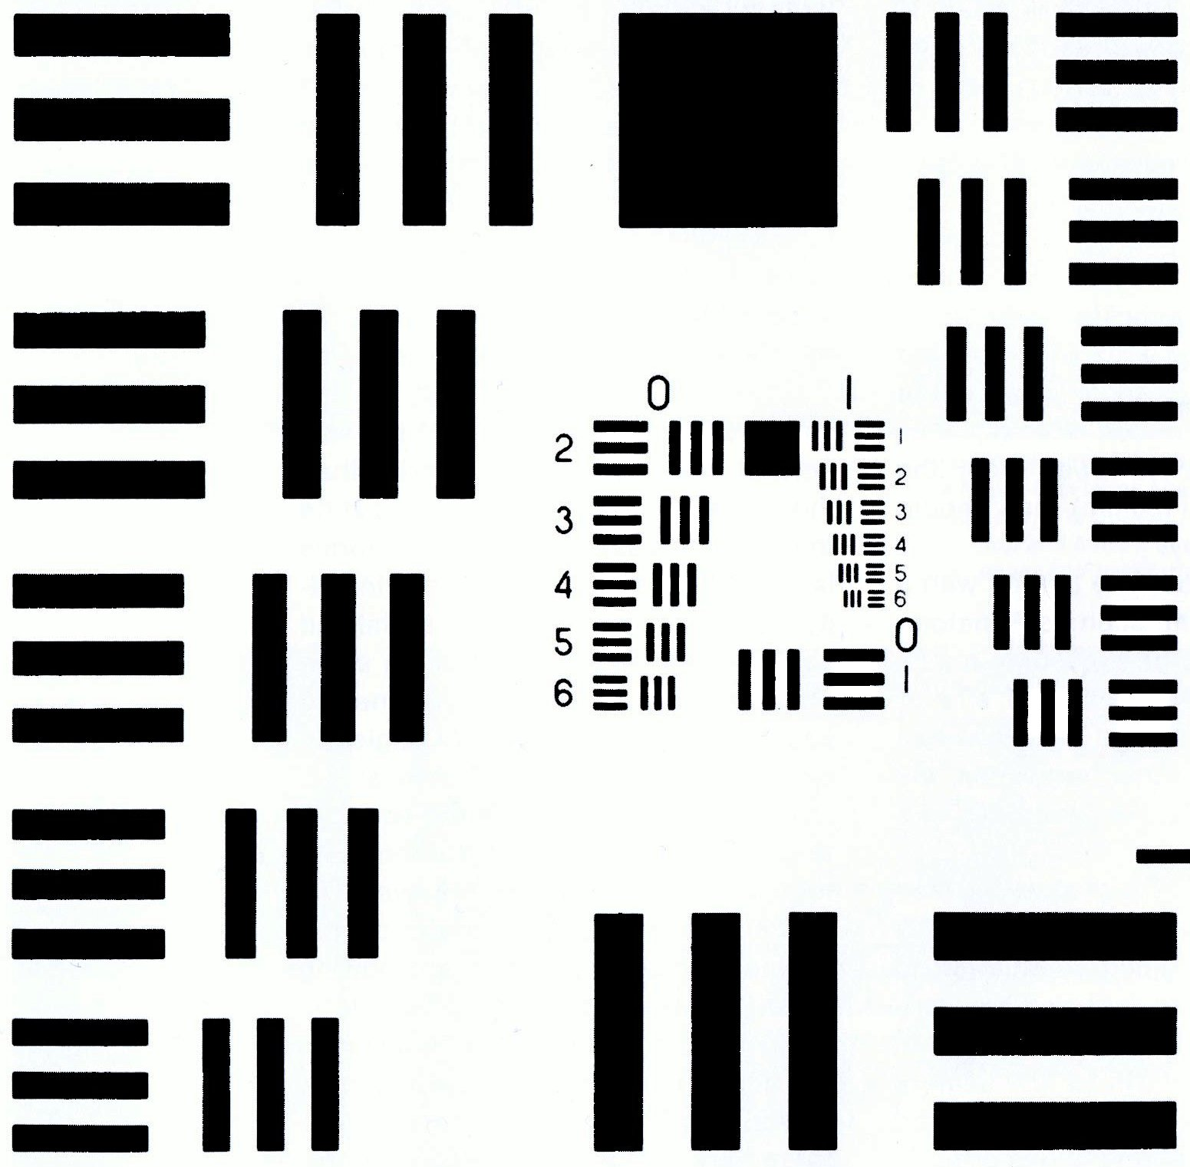
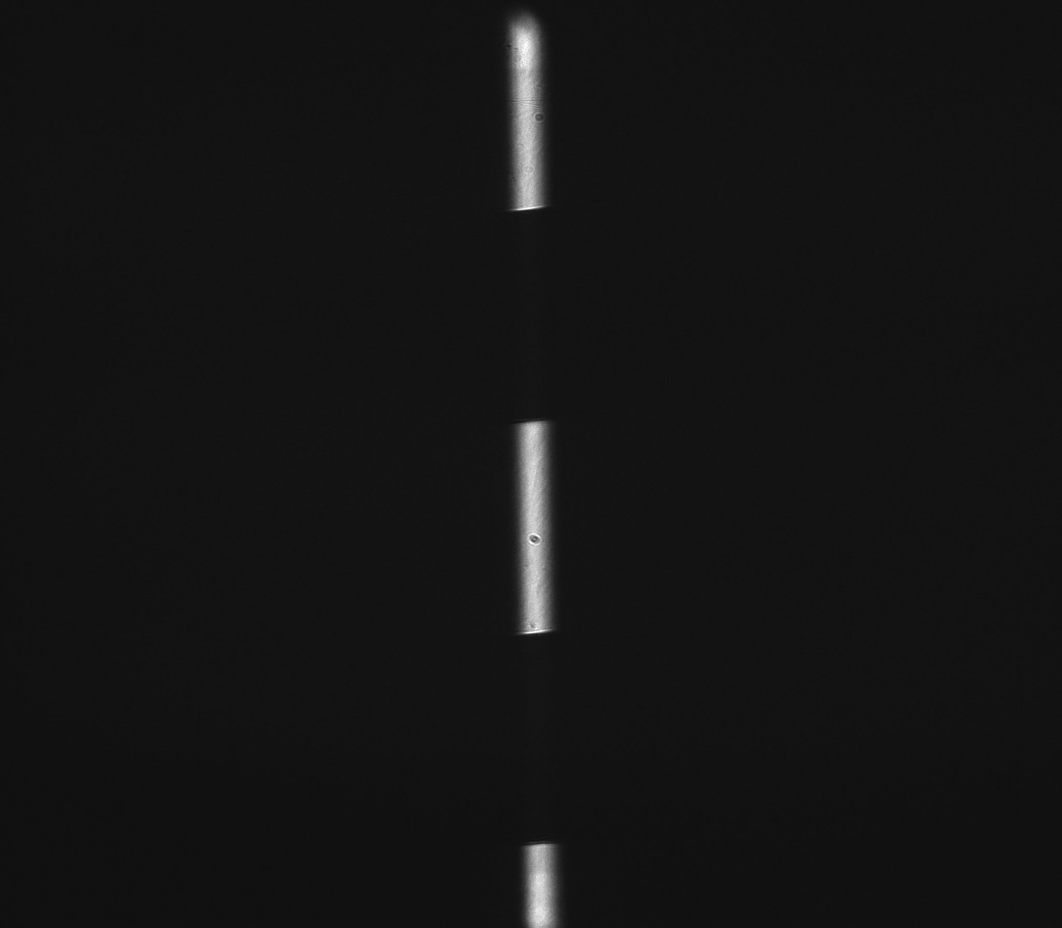
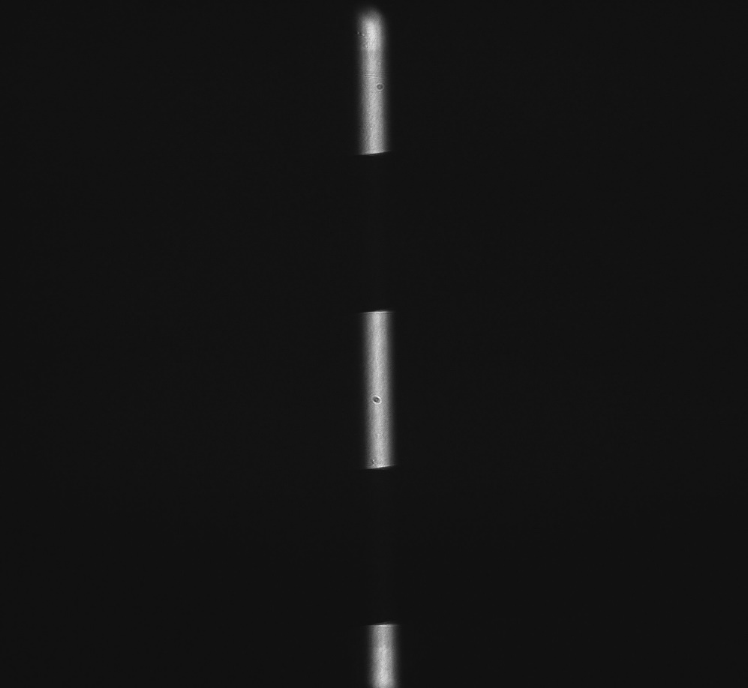
shape
mid

Slide 20
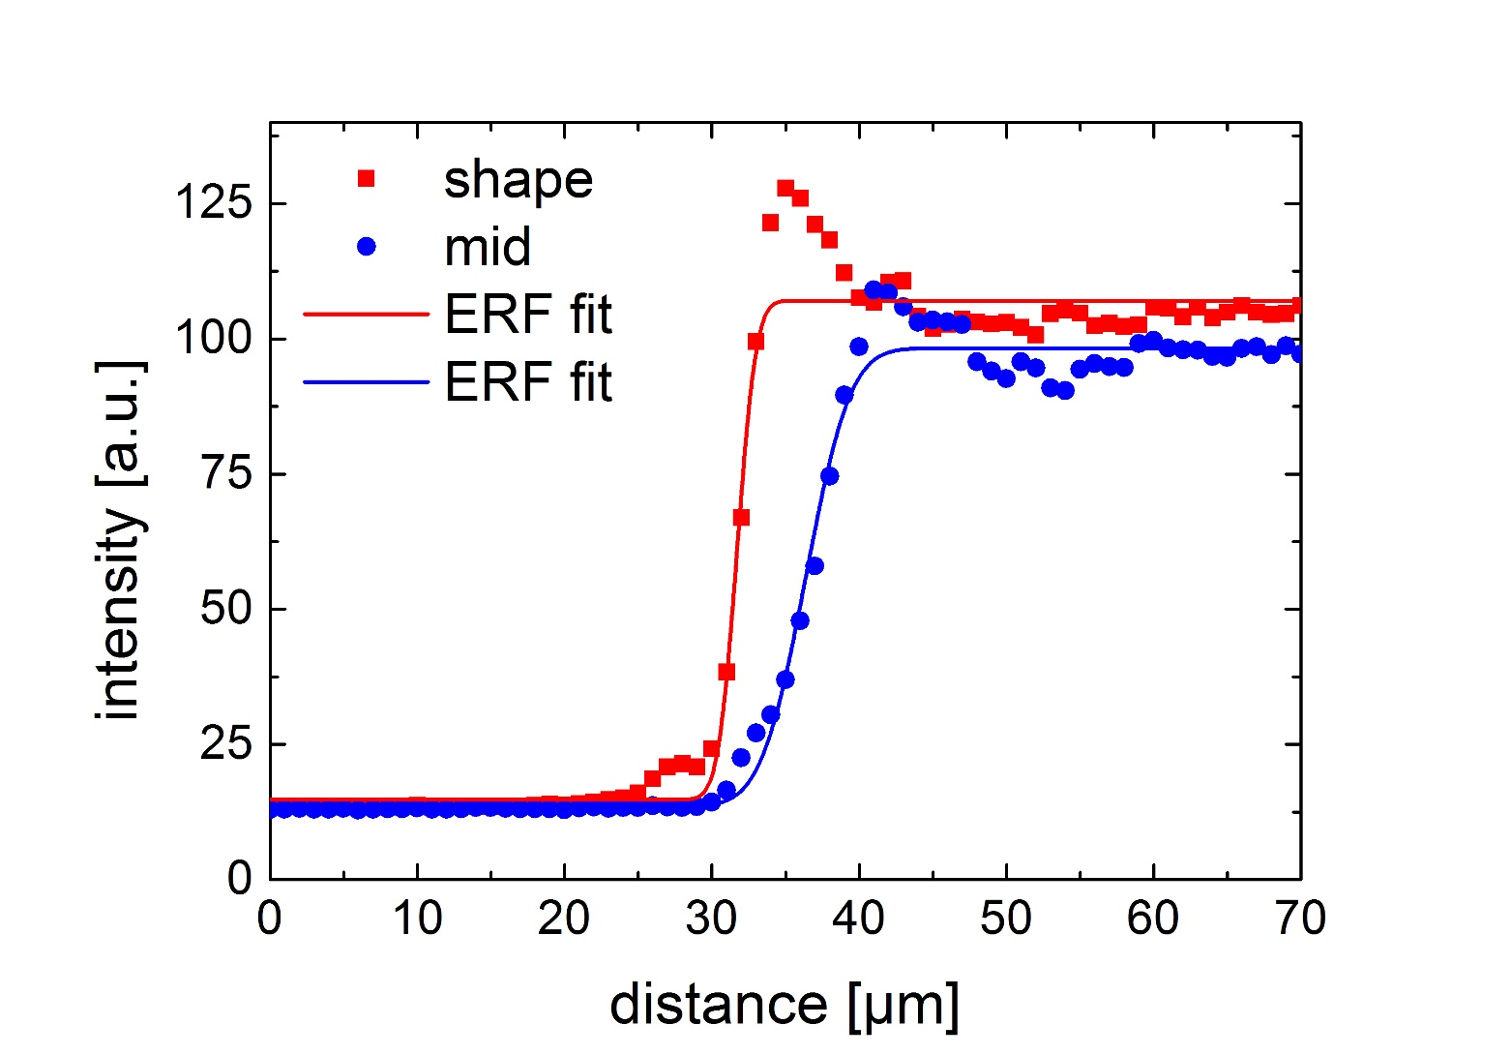
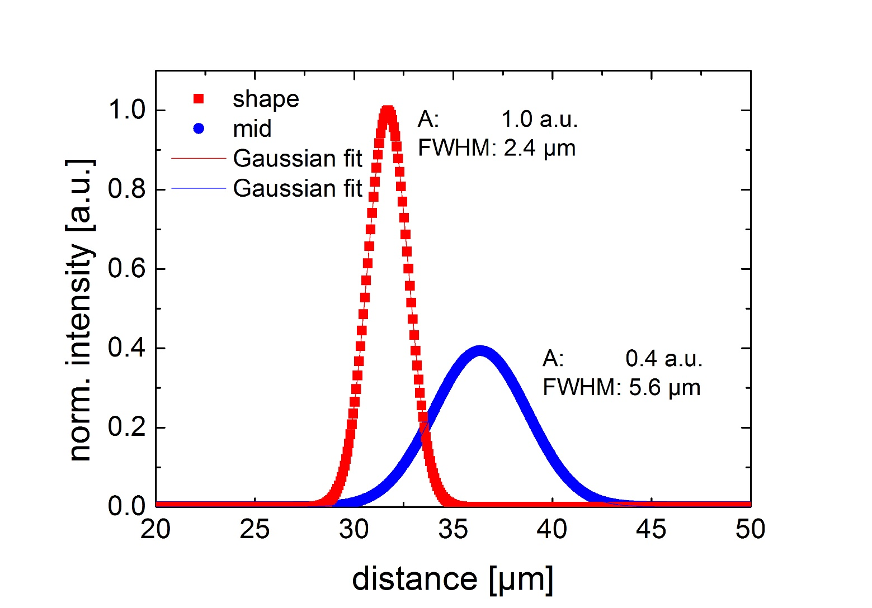

Slide 21
Realtime wavefront sensing in a SPIM microscope, and active aberration tracking (Invited Paper) Paper 9335-9 Time: 1:20 PM - 1:50 PM Author(s): Jonathan M. Taylor, Univ. of Glasgow (United Kingdom); Christopher D. Saunter, Cyril J. Bourgenot, Gordon D. Love, John M. Girkin, Durham Univ. (United Kingdom)

Slide 22








Acknowledgments
Bruno Weber
Matthias Schneider
Jean-Piere Ghobril
Marcel van ‘t Hoff
Ludovico Silvestri
Irene Costantini
Leonardo Sacconi
Francesco Pavone
Paolo Frasconi
Marco Paciscopi
Giulio Iannello
Alessandro Bria
Leonardo Onofri

Slide 23

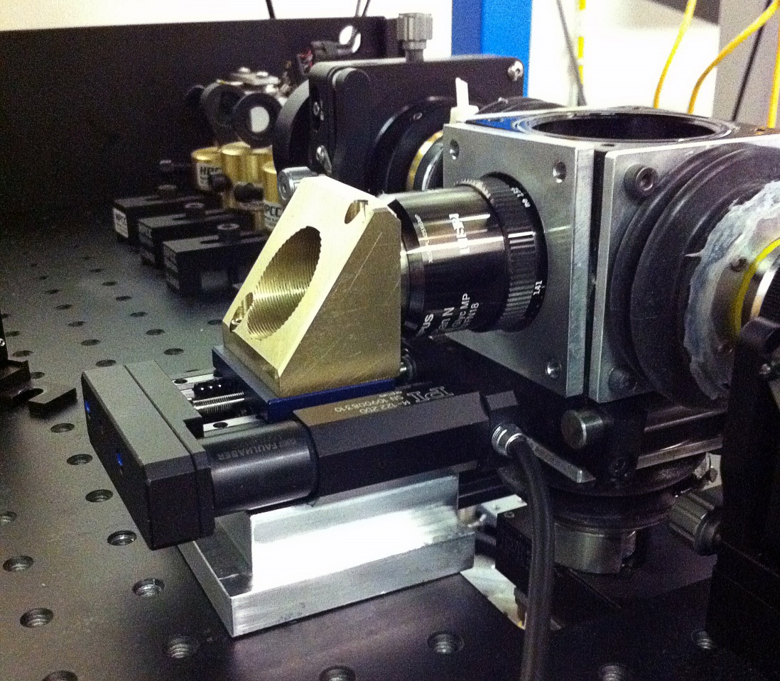
Our latest component: detection focus adaptation
optimizing parameters at every mm of tissue for all tiles
linearly interpolating the values
optimal parameters identified by finding maxima in a specified neighbourhood corresponding to image quality measure
to automate this process: optical focus-quality measure is the ratio of high frequency and low frequency signal in Fourier space

Slide 24
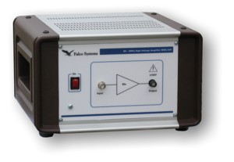

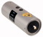
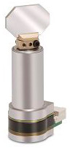
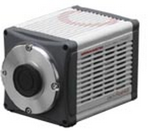
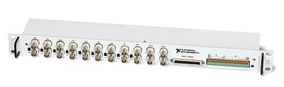



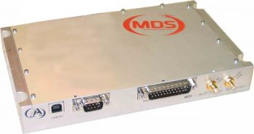
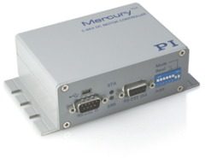


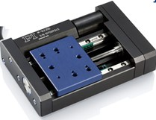
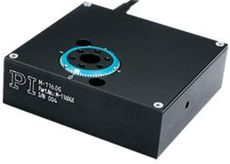
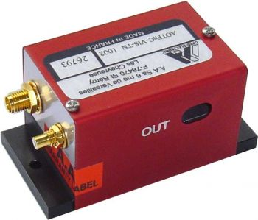
Connections
Pulse amplifier
EOM
Galvo 1
1 Gb/s ethernet
405 nm laser
10 Gb/s SFP+
Camera
DAQ
Galvo 2
445 nm laser
CameraLink
Co-axial
491 nm laser
HV co-axial
PC2
USB
RS-232 Hub
515 nm laser
RS232 Daisy Chain
PC1
RS-232
561 nm laser
RF co-axial
Internal bus
RF generator
Servo motor
Servo motor
Servo motor
Servo motor
AOTF
Supercomputing Centre
NAS
Translation x
Translation y
Translation z
Rotation stage

Slide 25
Camera
10 Gb Optical fibres
Remote repository
CINECA
CameraLink
board
10Gb network card
System
bus
Network-attached storage
32.4 TB
Raw data stream
Local SSD RAID 0
10.9TB
Data conversion stream
Transfer to remote repository
Workstation
Laboratory

Slide 26
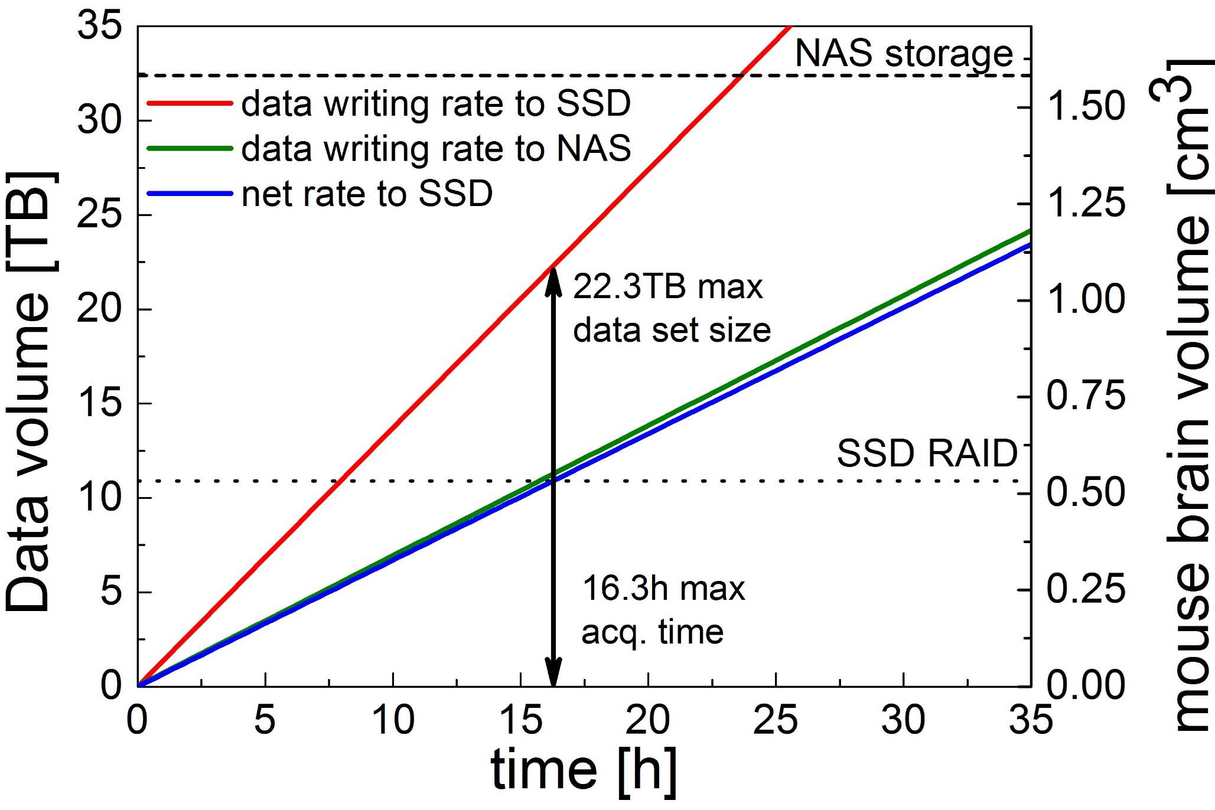

Slide 27
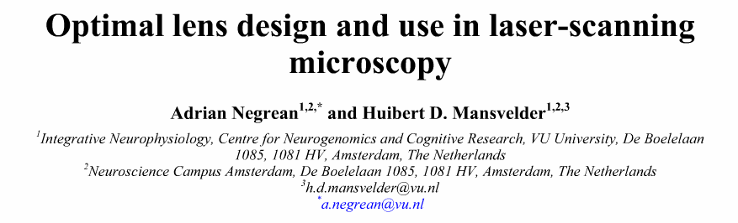
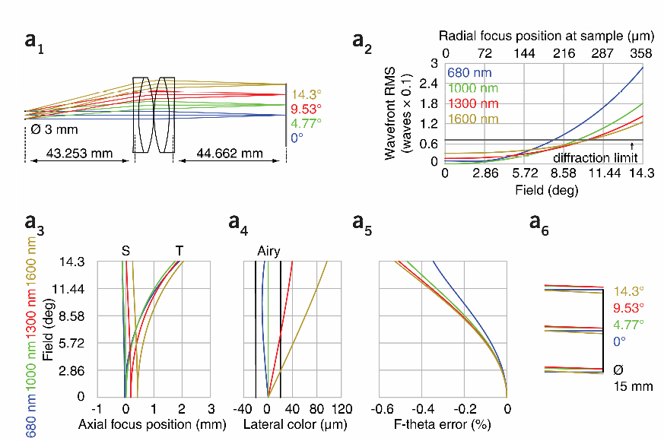
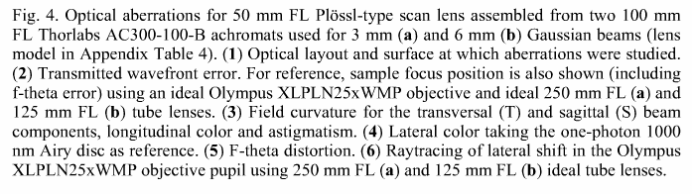

Slide 28

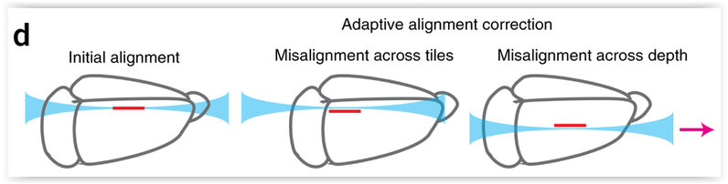
Initial alignment:
Red: focal plane detection objective
Blue:digitaly scanned light sheet
During image acquisition:
“Large clarified samples can have marked RI inhomogeneity, resulting in the need for correction of misalignment of illumination with the focal plane of the detection objective. We achieve this with a linear adaptive calibration procedure before starting the imaging experiment”

